Slide 1
Homework 1 – EDA/ETL
Avi Simkin – 312485816
Maximilian Matyash – 318828761

Slide 2
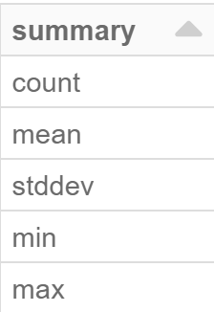
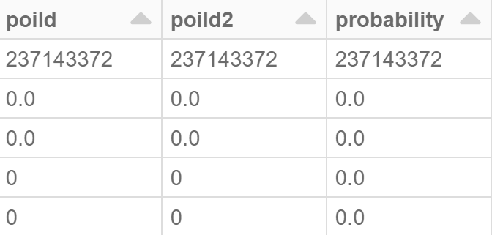
Extraction & Initial transformation
We called a Spark function to extract the data into a spark dataframe from the given source.
We had an initial look at the summary of the data and noticed that some columns have only one value (namely 0 or false) for all rows and decided to discard these columns(total of 6 such columns).
We also changed object column which had an object with a single property by extracting that property. In addition, we removed the “loc” column as its information is already present in the longitude and latitude columns.
For example, here we can see some column where min = max, therefore all values are the same and the column holds no information.

Slide 3
Sampling and Further exploration
We plotted box-plots for some of the columns and quickly discovered that the built-in plotting in databricks shows results based on just the first 1000 rows of the data.
This might give us a “feel” for the data, however the results that we see can be far from the actual distribution of the entire data. Thus we looked for outliers based on non graphical measures as given by the df.summary() function, specifically the interquartile range.
We took a sample of 10% (about 20 mil rows) from the data in order to have more informative graphs. This is better than the first 1000 rows that spark takes because it’s a random sample and it takes much more data.

Slide 4

Insights

Slide 5
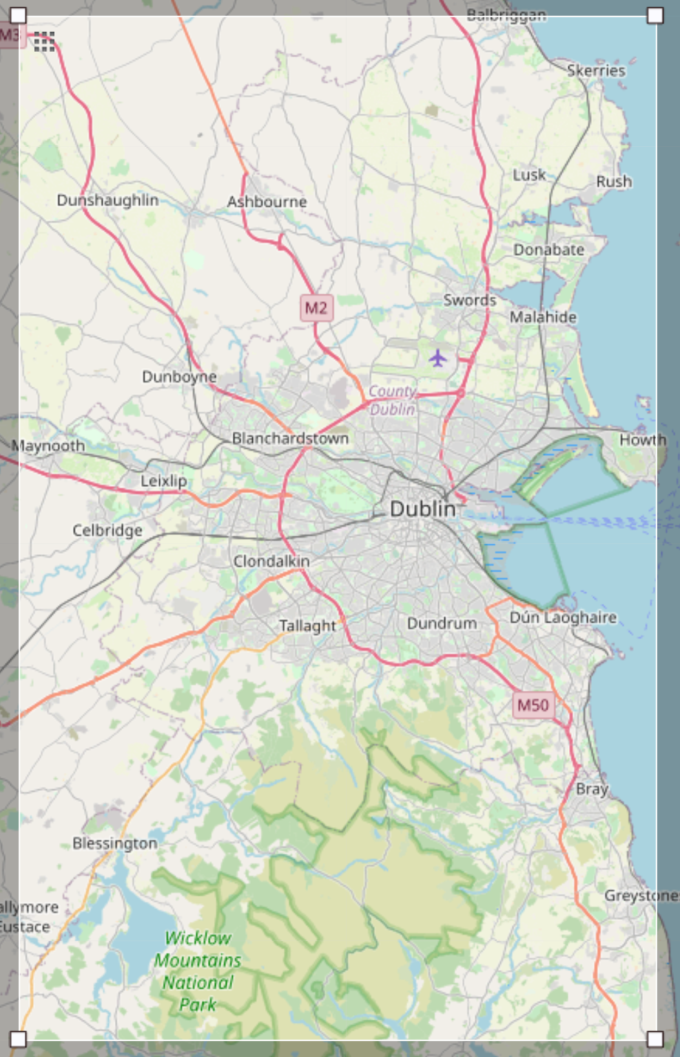
Geographical Location
As the data had longitude and latitude features, the most intuitive thing to first was to understand where we are. So, we found a website for that (https://www.openstreetmap.org/) and gave it the minimum and maximum values of each coordinate in our data, resulting in the map shown to the side.
We can see that our data comes from Dublin, Ireland.

Slide 6
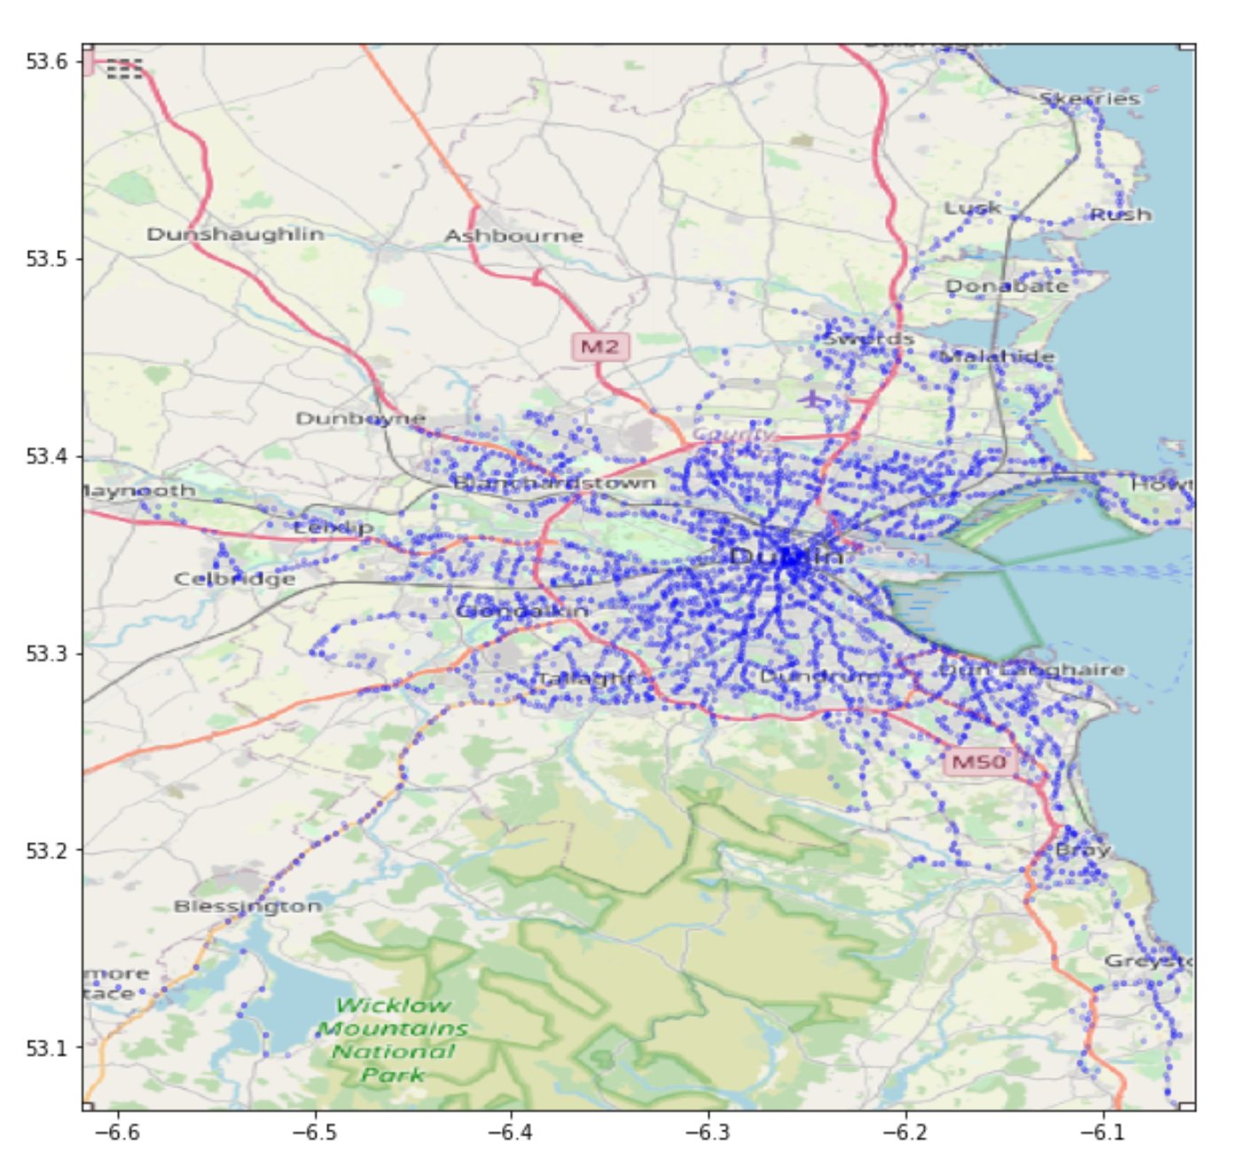
In addition, we wanted to see the locations of bus stops on the map in order to reassure that the data makes sense (i.e. that bus stops are in sensible places).
We aggregated the average longitude and latitude of each stop given the bus reported stopping and plotted the result based on our 10% sample.
Indeed, when we plot the stops on the map of Dublin, we get a sensible image, i.e. the stops are along streets.
It is also noticeable that there are more stops the closer you get to the center of the city.
We can also notice 3-4 distinct “branches” going in and out of the city.

Slide 7
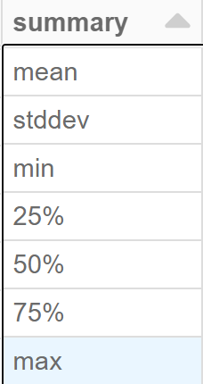
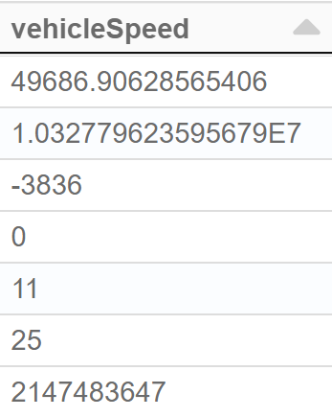
Possibly Unreliable Data
While looking at the data summary for each column we noticed that the vehicle speed column has a very high variance and values that don’t make sense.
Regardless of which units were used to measure the speed, values over 200 don’t make sense, especially if there are some values in the thousands or even millions (unless the bus was moving at 10 times the speed of light)
We therefore suspect the vehicle speed is measured unreliably and will have to account for that in the future and maybe treat some of these values as missing. (it wouldn’t make sense to drop their rows entirely since the other readings seem reasonable, especially the important ones, the latitude and longitude, which we’ve seen to make sense on the map of Dublin).
We can see that the standard deviation is extremely high, and the minimum/maximum values don’t make sense for any units of speed.

Slide 8
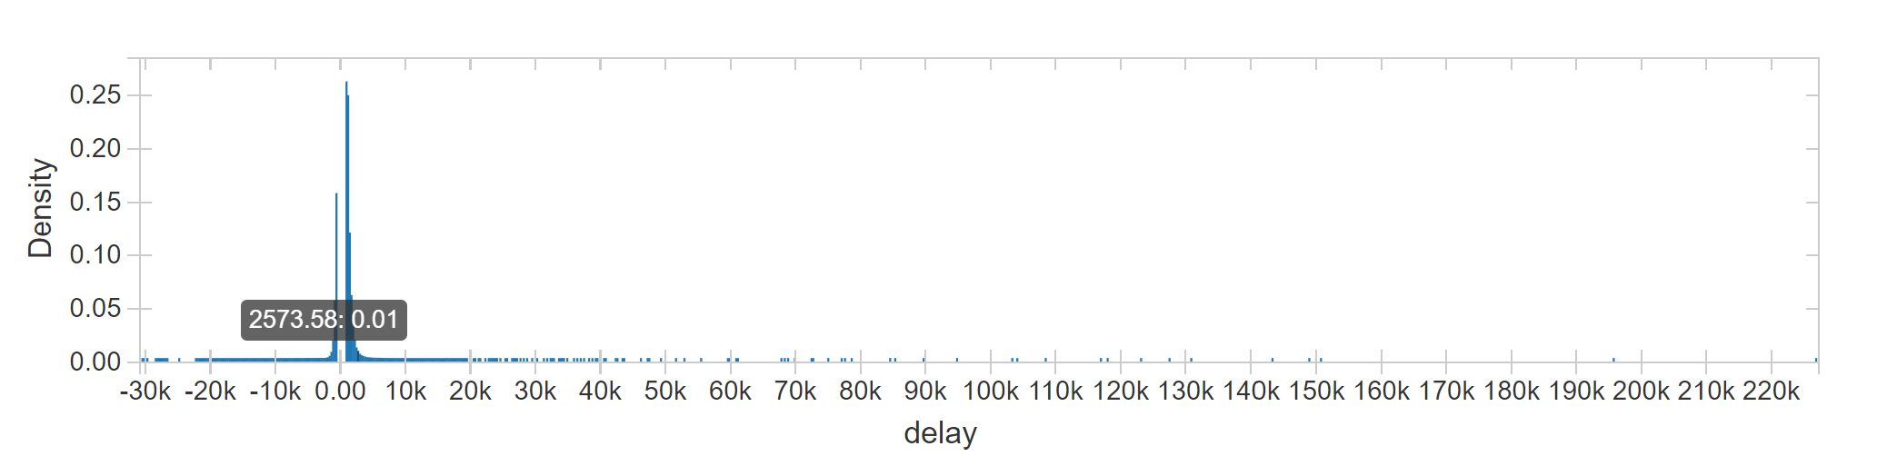
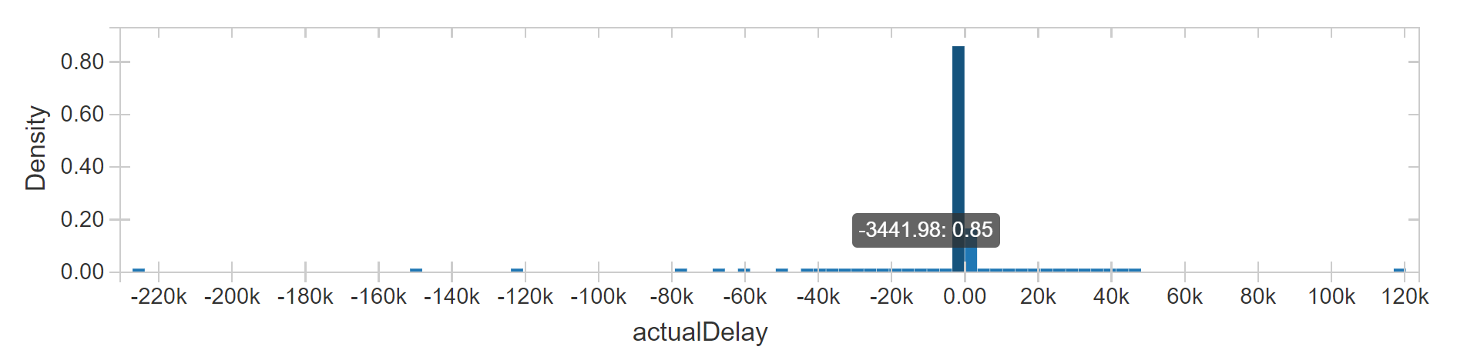
Similarly, although to a less extreme degree, we saw that the delay and actual delay column have this issue.
We made histograms of the possible outliers (according to the interquartile rule) to see possible cutoff points. However, at this time we prefer to treat these readings as missing or unreliable in order to keep as much data as possible (might just remove some of them later).

Slide 9
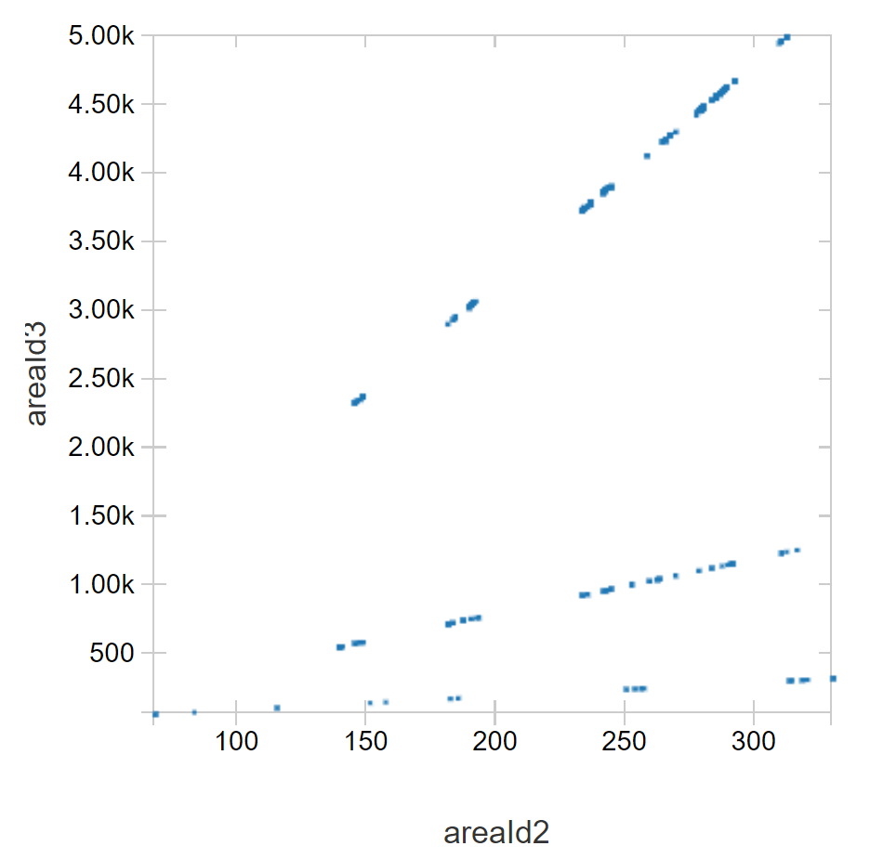
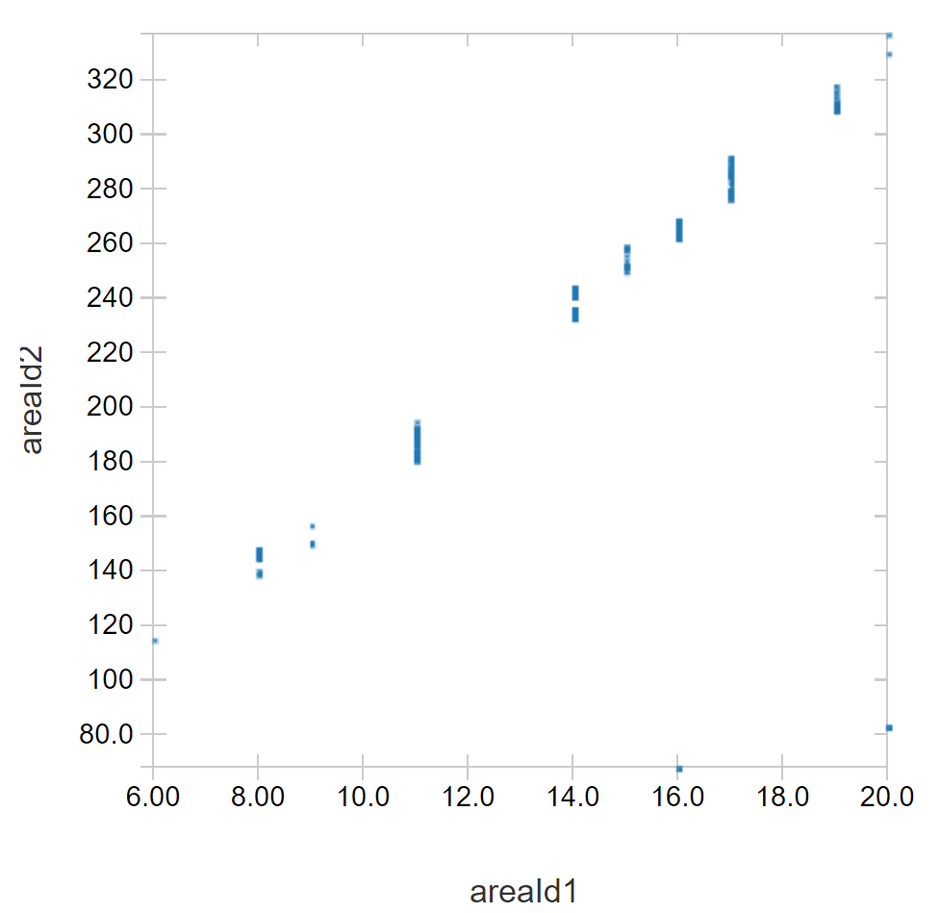
Area Subdivision
More geographical information can be derived from the area ID 1-3 columns.
If we plot these columns by pairs, we recognize one-to-one relations between them.
This means that area ID 2 is a subdivision of area ID 1 and area ID 3 is a subdivision of area ID 3.

Slide 10
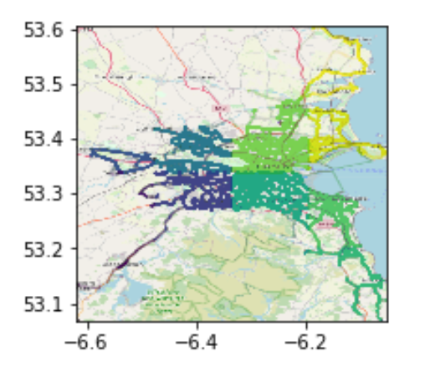
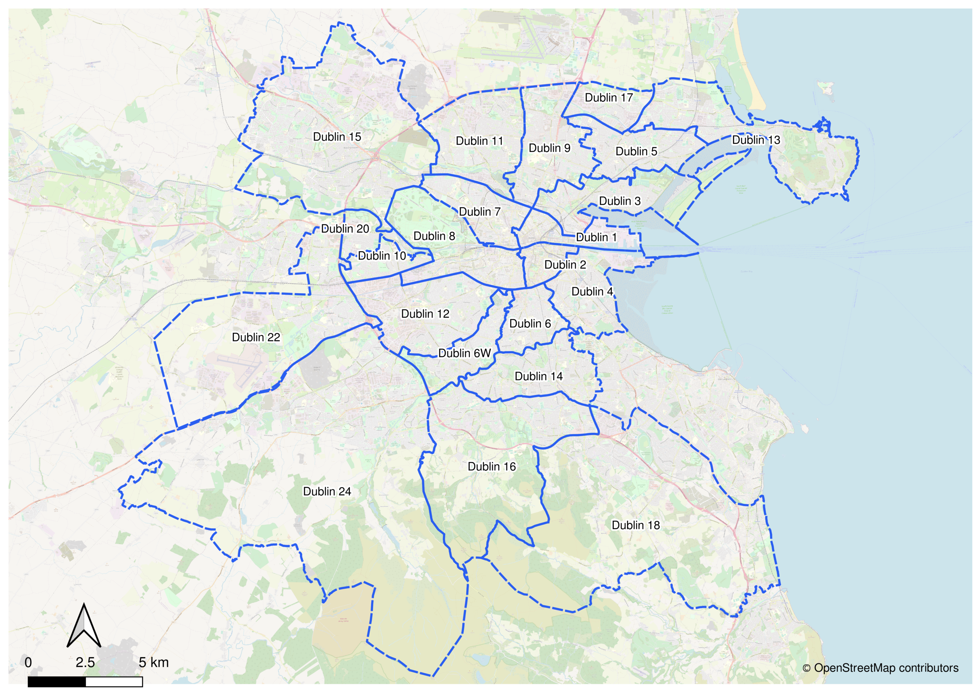
If we plot the area ID 1 subdivision, we can see it divides regions of the city according to the cardinal directions as well as coastal areas.
This roughly corresponds to Dublin’s postal districts, although not entirely since there are more postal districts than values for area ID 1.
On the left, a division of Dublin according to area ID 1.
On the right Dublin’s postal districts.
We can’t say for sure what the other area ID’s correlate to, however, area ID 3 might be related to the townlands of Dublin since they are similar in size.

Slide 11

Loading the Data

Slide 12
Data Warehouse
We chose ElasticSearch as our data warehouse and installed it on our VM, we chose this due to the following reasons:
Kibana – it's a powerful data visualization and analysis tool that's integrated with Elasticsearch and is pretty useful to us as we have geo data.
Big Data – we have a pretty big dataset on our hands(237M records) and Elasticsearch is known to perform very well on big datasets with its efficient indexing mechanism.
Accessibility – Elasticsearch is easily(bugs and wrong configs aside) accesible through Databricks in which Elasticsearch library is already installed on the cluster. Furthermore, It's a popular tool with info about it in the web.

Slide 13
Transformations
Following the insights from the EDA we did the following transformations:
Removing uninformative columns, such as:
Direction, dateTypeENUM, filteredActualDelay, loc, poiID,poiID2, probability
We extracted the timestamp and geo locations from the json-type instances in that particular column
We added a column that categorizes the time of day to section – Morning, Noon, Afternoon, Evening and more. We did this as this may become helpful for ML models.
We renamed a column with uninformative name - "dateType" which refers to the question whether it's weekend or not.

Slide 14
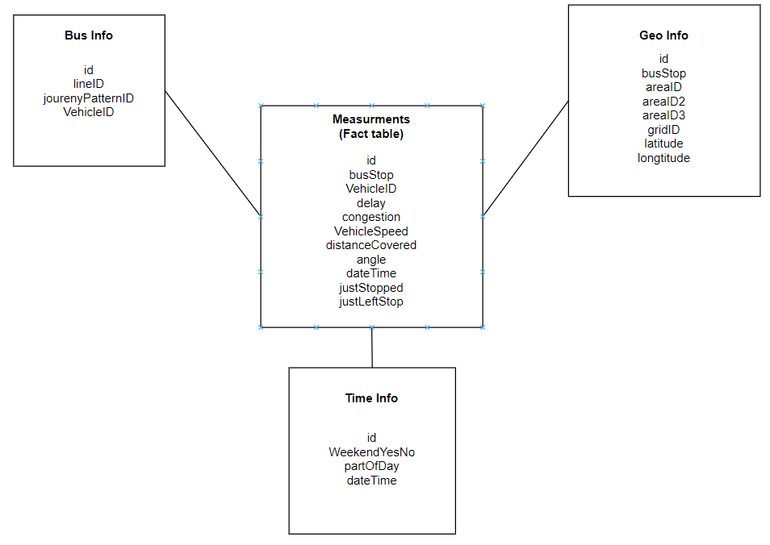
Loading the data
In order to load the data we first divide it into 4 tables (star shaped) with the next ERD:

Slide 15
A little about our ERD
Due to the structure of our dataset, we thought that the most natural division is having 3 dimension tables(geo, time and bus info) and a fact table that will contain all the dynamic data. In this particular structure we have smaller and more focused tables in which we have less column-redundancies, while of course maintaining data-completeness (we can later join all the tables to have the one table with all the clean and transformed data).

